Slide 1
Lecture 3: introduction to object detection using OpenCV
Instructor: Jianfeng(Jeff) Ren

Slide 2
Introduction to OpenCV Summer 2015, Tuesday/Thursday 7:00-9:00pm
Do you want to make your computer react human gestures? Do you want to make your car drive more safety? Do you want to make your home more security? Do you want to build one of the above systems with your hands? Get answers to all these questions and more at the Workshop “OpenCV”!
This class will get you prepared to quickly implement your computer vision related ideas using OpenCV.
Instructor:
Dr. Jianfeng(Jeff) Ren
Multimedia R&D, Qualcomm Inc

Slide 3
Object detection
The goal of object detection is to find an object of a pre-defined class in a static image or video frame.
AdaBoost based solution;
Other Uses of AdaBoost
•Human/Pedestrian Detection & Tracking
•Face Expression Recognition
•Iris Recognition
•Action/Gait Recognition
•Vehicle Detection
•License Plate Detection & Recognition
•Traffic Sign Detection & Recognition
Other Features Used in AdaBoost weak classifiers
•Histograms of Oriented Gradients (HOGs)
•Pyramidal HOGs (P-HOGs)
•Shape Context Descriptors
•Region Covariances
•Motion-specific features such as optical flow & other filter outputs

Slide 4
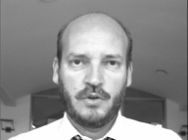

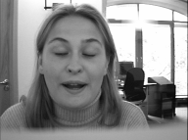

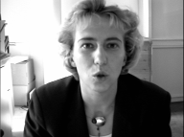
Methods
Simple objects
Extracting certain image features, such as edges, color regions, textures, contours, etc.
Complex objects
Learning-based method:
Viola and Jones, “Rapid object detection using a boosted cascade of simple features”, CVPR 2001

Slide 5
Statistical model-based training
Take multiple “positive” samples, i.e., objects of interest, and “negative” samples, i.e., images that do not contain objects.
Different features are extracted from samples and distinctive features are “compressed” into the statistical model parameters.
It is easy to make an adjustment by adding new positive or negative samples.

Slide 6
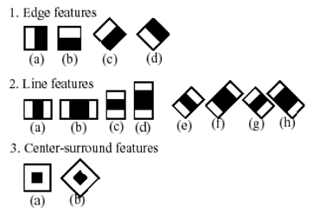
Haar-like Features

Slide 7
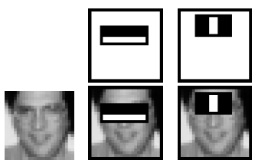
Example
Feature’s value is calculated as the difference between the sum of the pixels within white and black rectangle regions.

Slide 8
Adaboost Learning
The more distinctive the feature, the larger the weight.

Slide 17
Detector in Intel OpenCV
Collect a database of positive samples and a database of negative samples.
Mark object by objectmarker.exe
Build a vec file out of positive samples using createsamples.exe
Run haartraining.exe to build the classifier.
Run performance.exe to evaluate the classifier.
Run haarconv.exe to convert classifier to .xml file

Slide 18
Homework Assignment
Follow the OpenCV detector training procedure, could you train your own detector?
Collection positive data/negative data;
Labelling the region of interest in the positive data;
Training using the OpenCV haartraining.exe ;
Test using OpenCV detector;

